Slide 1
Streamlining Processes with PL/SQL and Tableau
Jen Abinette

Slide 2
Payment Types
Voucher
Travel & Expense Report

Slide 3
Streamlining Processes
Set up
Set up Oracle database with links to necessary data sources
Build
Build risk assessment into PL/SQL Package
Job Scheduler
Schedule recurring job to run PL/SQL Package everyday
Tableau
Use Oracle database as Tableau data source & Schedule Refreshes

Slide 4
What is a PL/SQL Package?
PL/SQL is an Oracle procedural extension of SQL
A package is a schema object that groups logically related PL/SQL types, variables, constants, subprograms, cursors, and exceptions. A package is compiled and stored in the database, where many applications can share its contents.

Slide 5
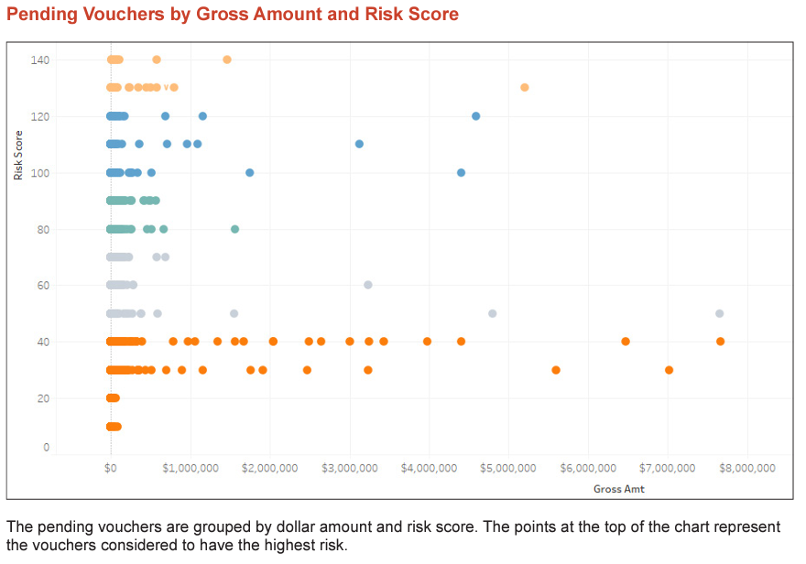

Slide 6
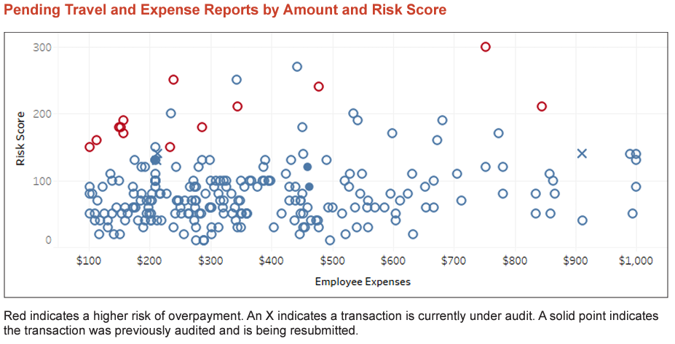

Slide 7
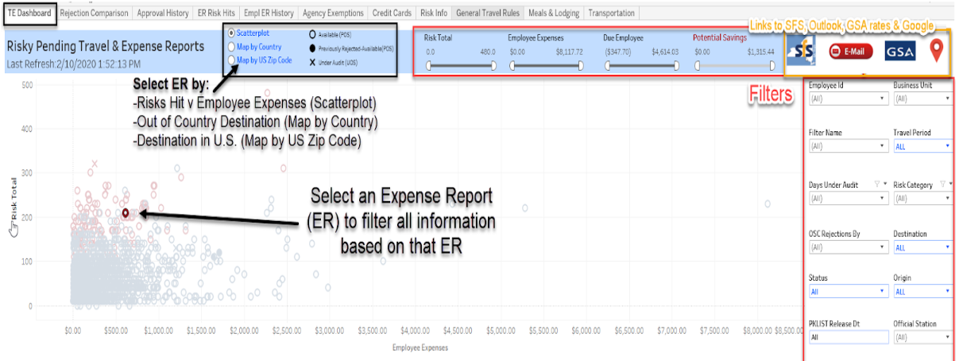
Let’s Streamline This Process

Slide 8
Impact
Resulted in an increase of more than 1,000 percent in audit findings from the prior year
During the period from July 1, 2021 through June 30, 2022, auditors using these tools identified audit findings worth almost $16 million, included duplicate payments, vendors not complying with contract terms, vendors calculating invoice amounts incorrectly, payments using lapsing funds, employees exceeding federal meal and lodging per diem rates and inappropriate purchases.

Slide 9
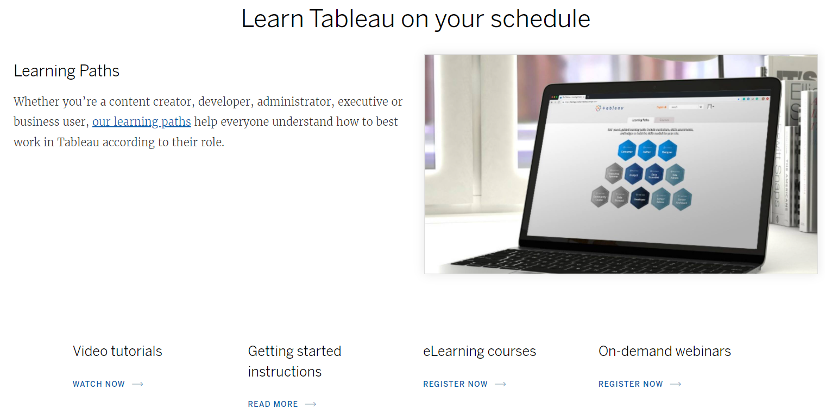
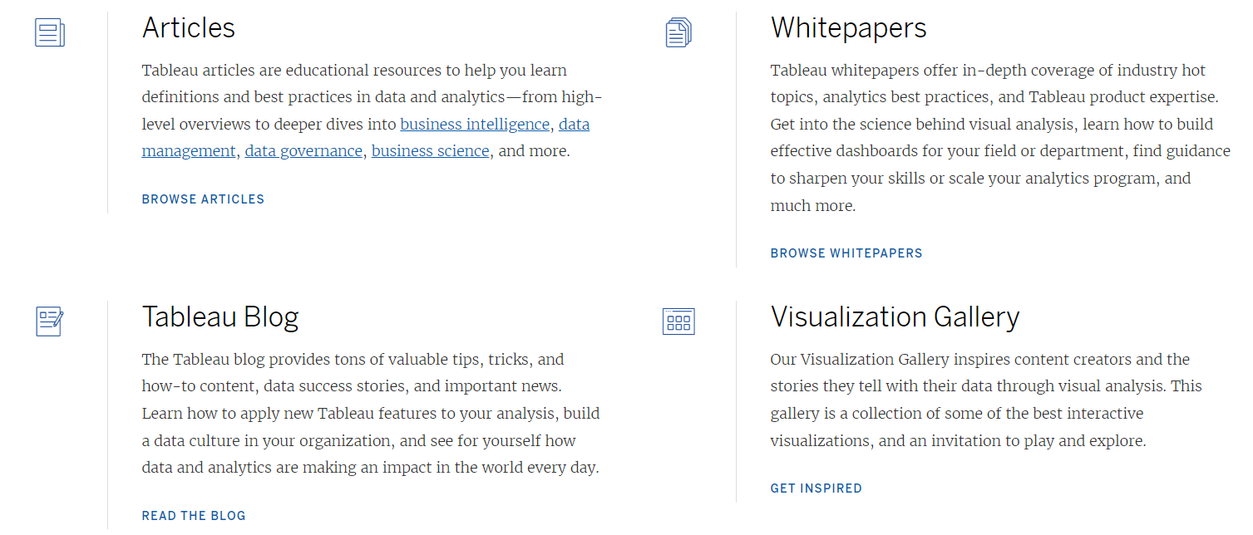

Slide 10
Resources
OSC Enterprise Reports
https://www.osc.state.ny.us/reports?combine=&combine=Enterprise
Oracle PL/SQL Overview
https://docs.oracle.com/database/121/LNPLS/overview.htm#LNPLS00102
Tableau Resources
https://www.tableau.com/resources

